Slide 1
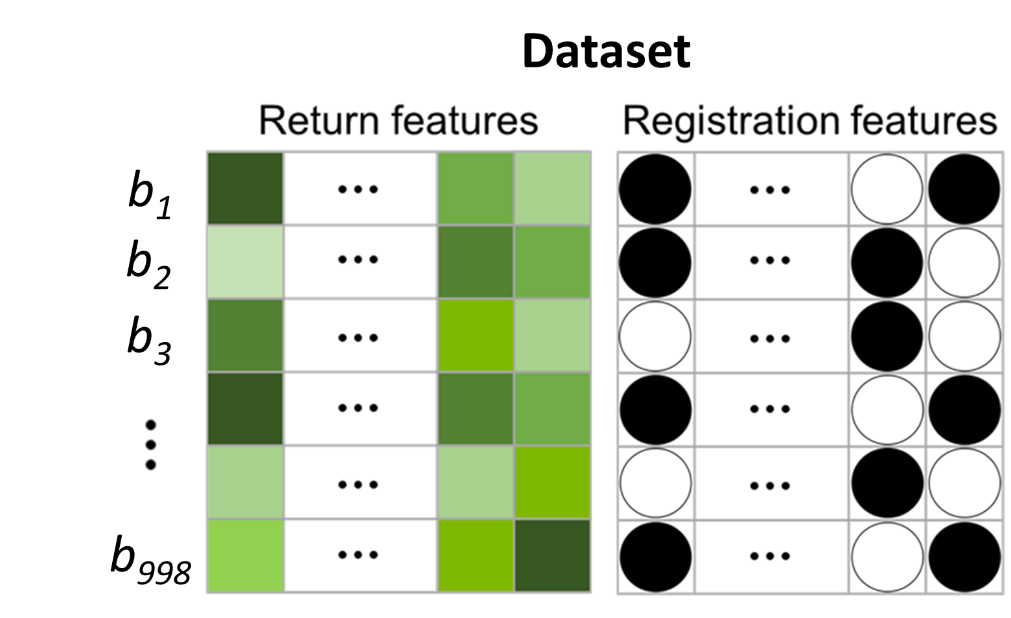
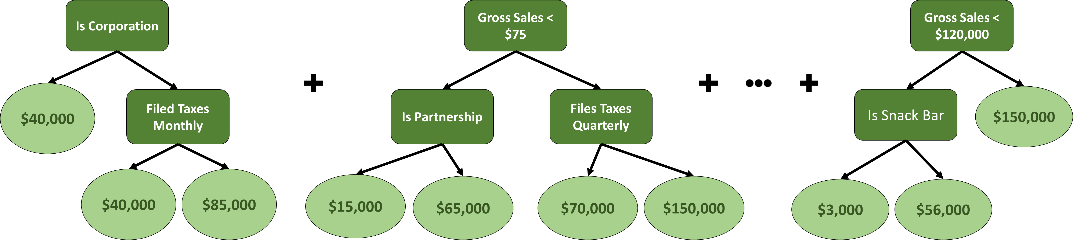
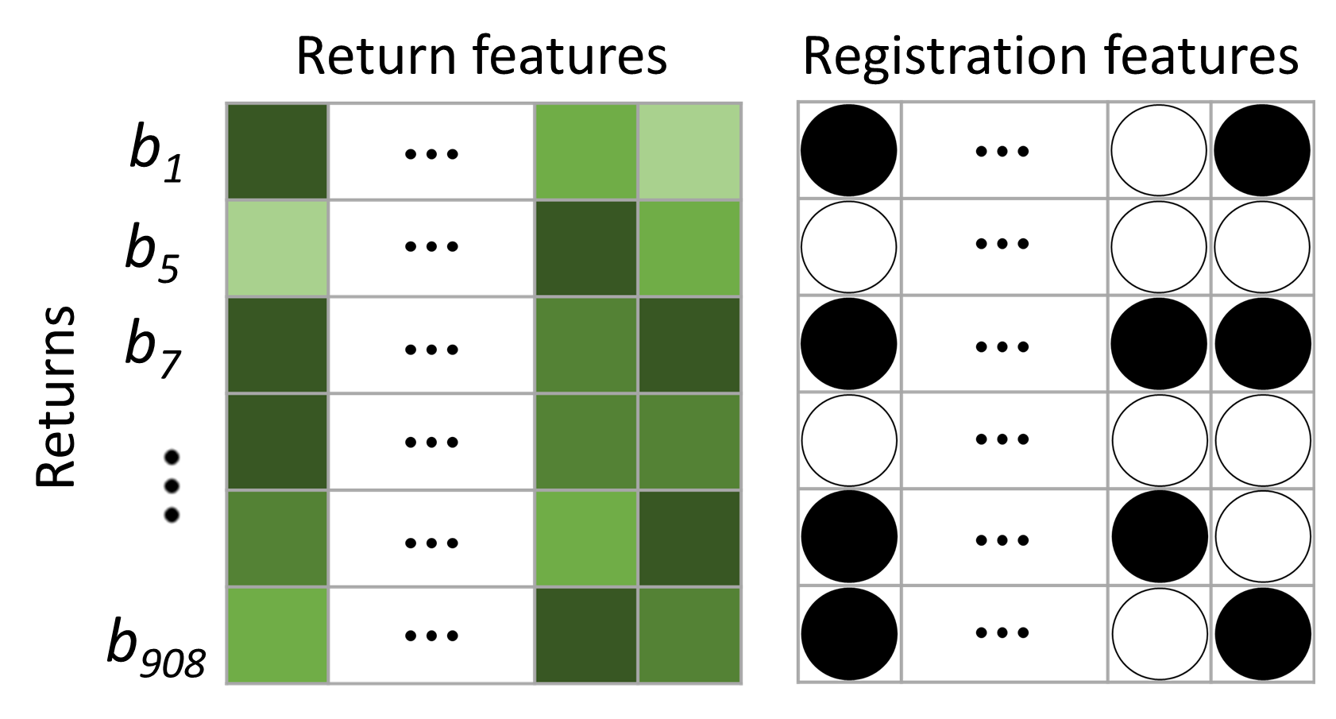
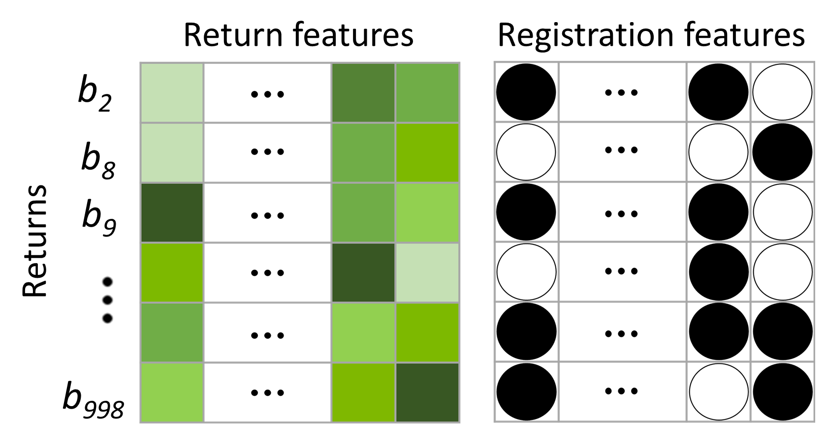
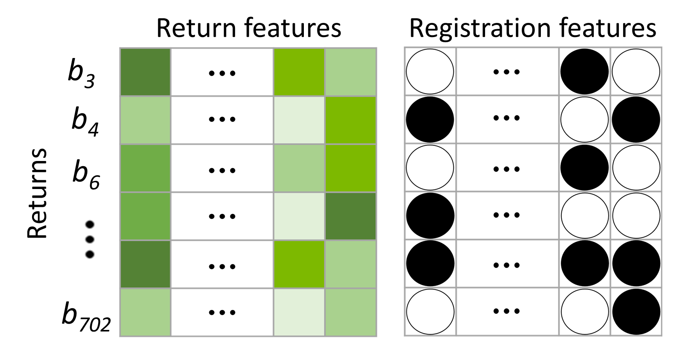
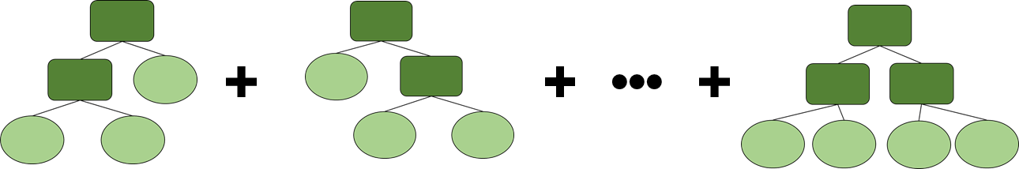
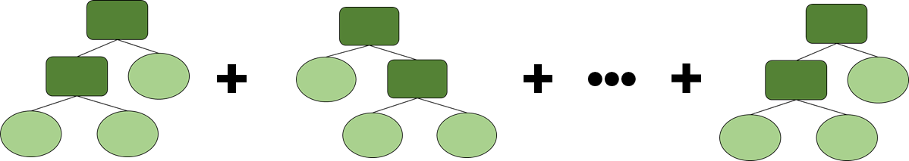
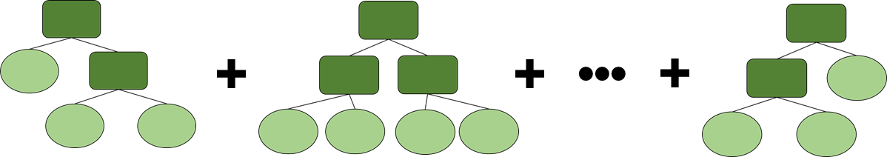
Extreme Gradient Boosted Trees
Returns
Limited-Service Restaurant Returns
Mobile-Service Restaurant Returns
Other Restaurant Returns
Predicted audit yield grouped by mean per business

Slide 2
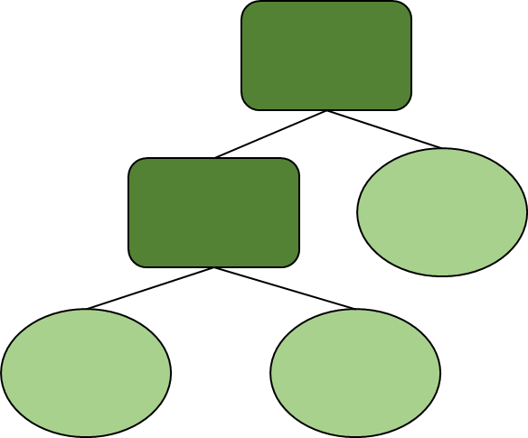
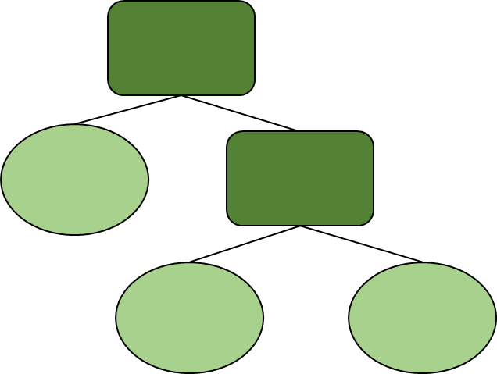
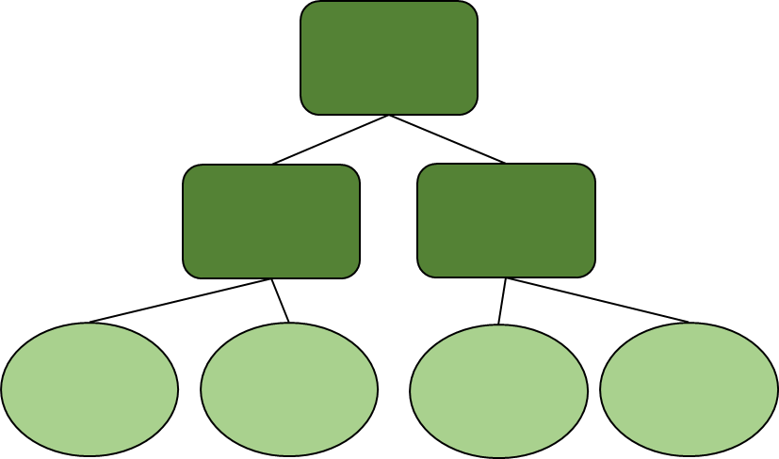
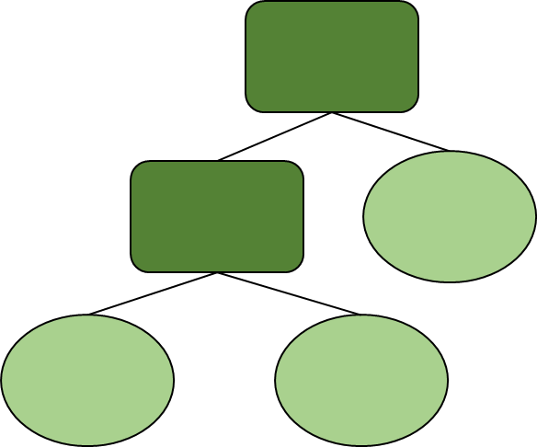
Is Corporation
Gross Sales < $75
Gross Sales < $120,000
$40,000
$150,000
Filed Taxes Monthly
Is Partnership
Files Taxes Quarterly
Is Snack Bar
$40,000
$85,000
$15,000
$65,000
$70,000
$150,000
$3,000
$56,000

Slide 3
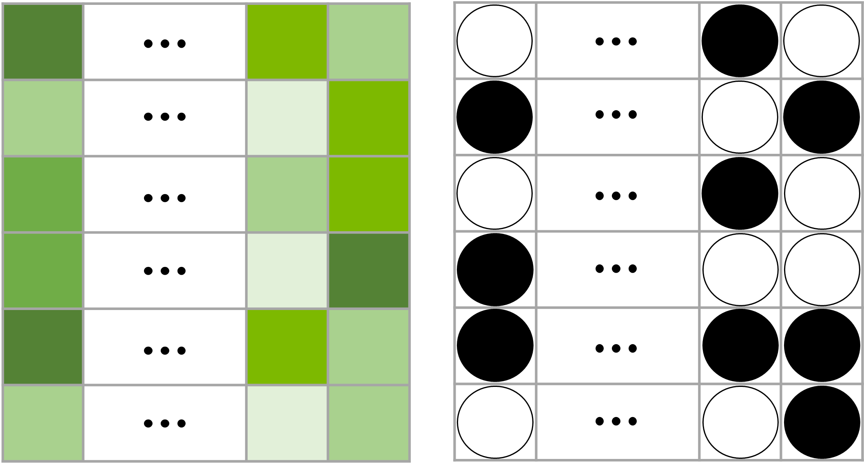
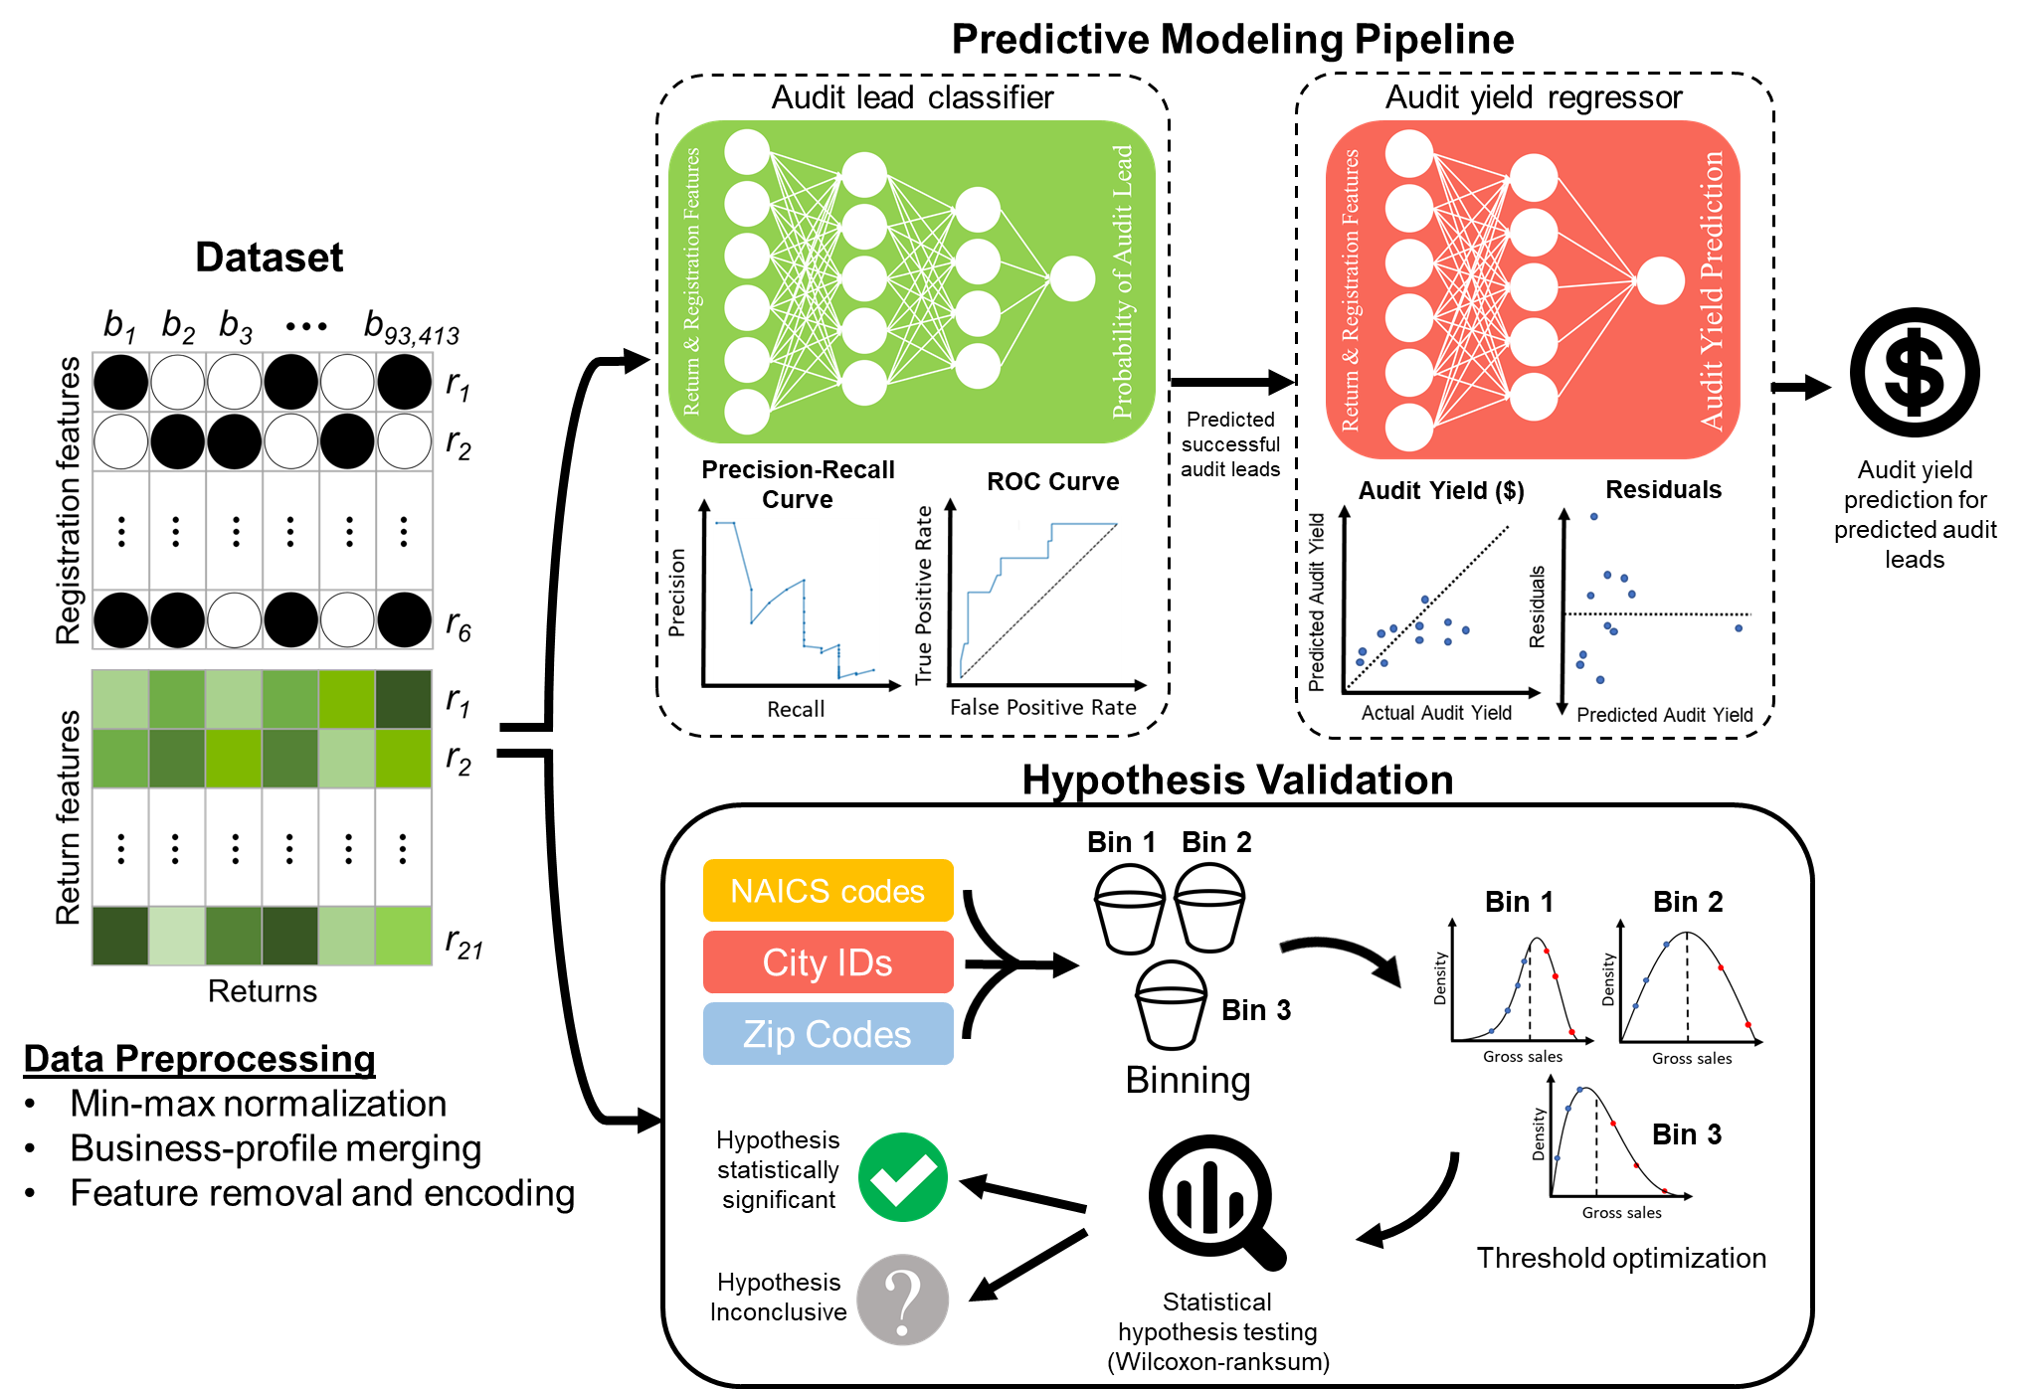
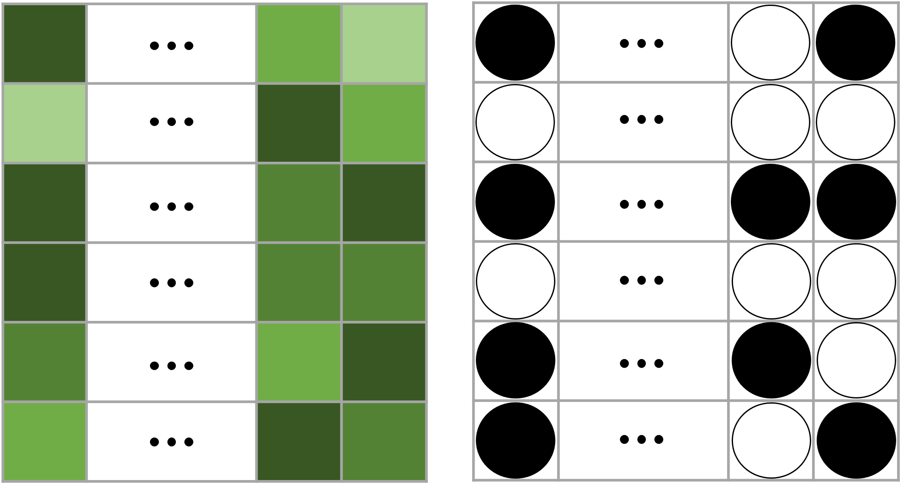
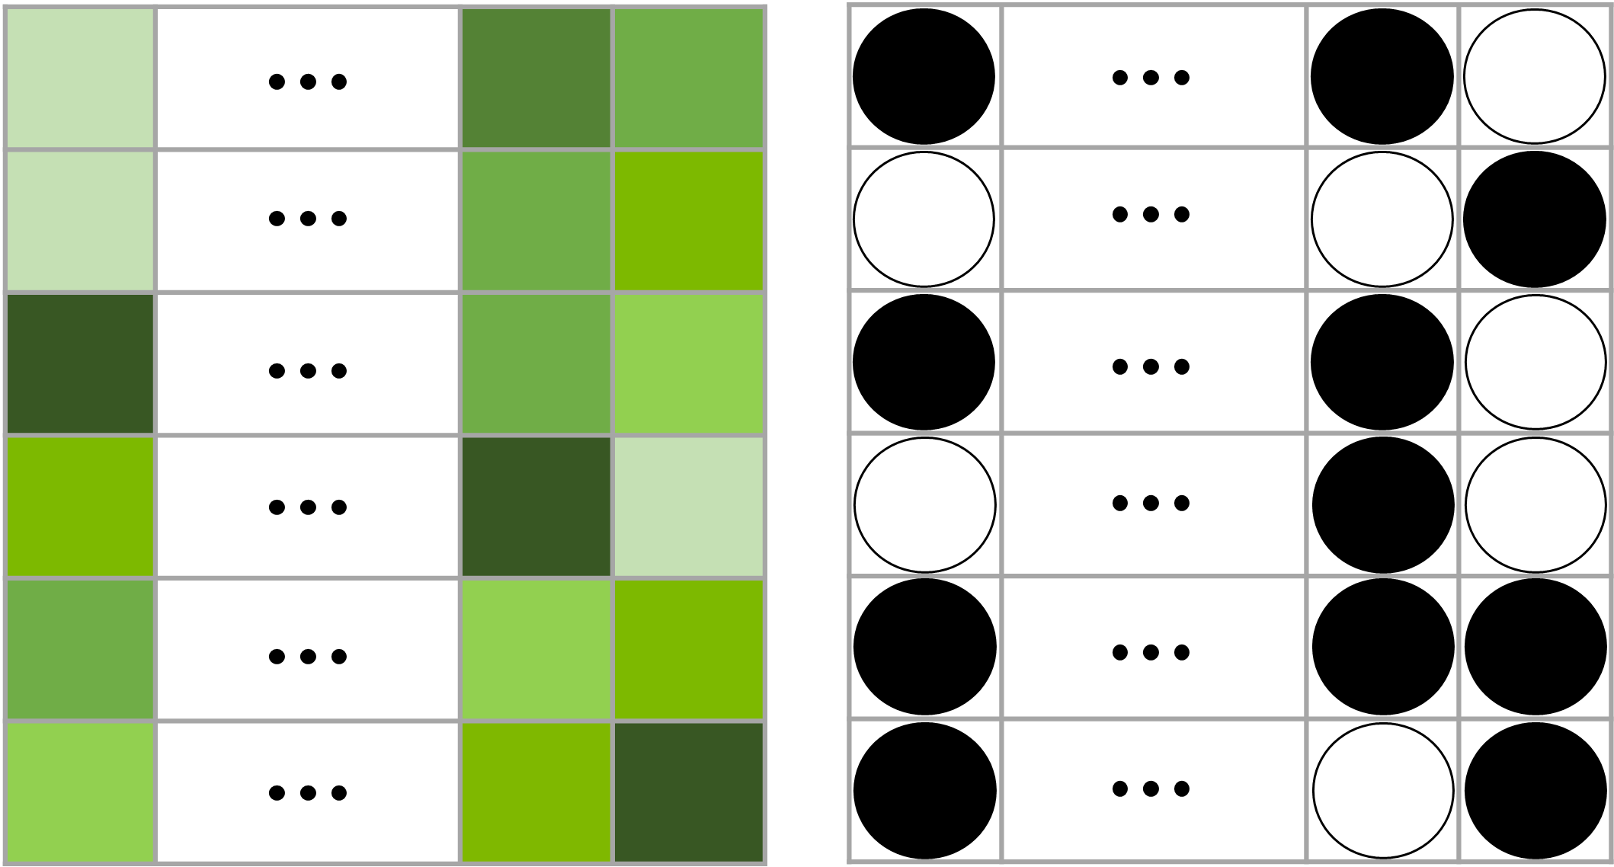
Mobile-Service Restaurant Returns
Return features
Registration features
b₃
b₄
b₆
Returns
b₇₀₂
Limited-Service Restaurant Returns
Dataset
Return features
Registration features
b₁
b₁
b₂
b₅
b₃
b₇
Returns
b₉₉₈
b₉₀₈
Other Restaurant Returns
Return features
Registration features
b₂
b₈
b₉
Returns
b₉₉₈

Slide 4
Limited-Service

Slide 5
Mobile-Service

Slide 6
Other

